Slide 1

Healthcare Analytics
Healthcare Analytics
Pre Screening Tool
Paul Bih
Amber Dodson
William Lubenow
Jess Ramirez
Graciela Zamudio

Slide 2


Vision
Build and deploy a web app to help pre-screen patients.
Help with early, accurate, and speedy detection of diseases.
Address the shortage of healthcare providers by limiting in-person visits.
Provide healthcare systems with cost-effective analysis.
Improve workflow for healthcare professionals.

Slide 3
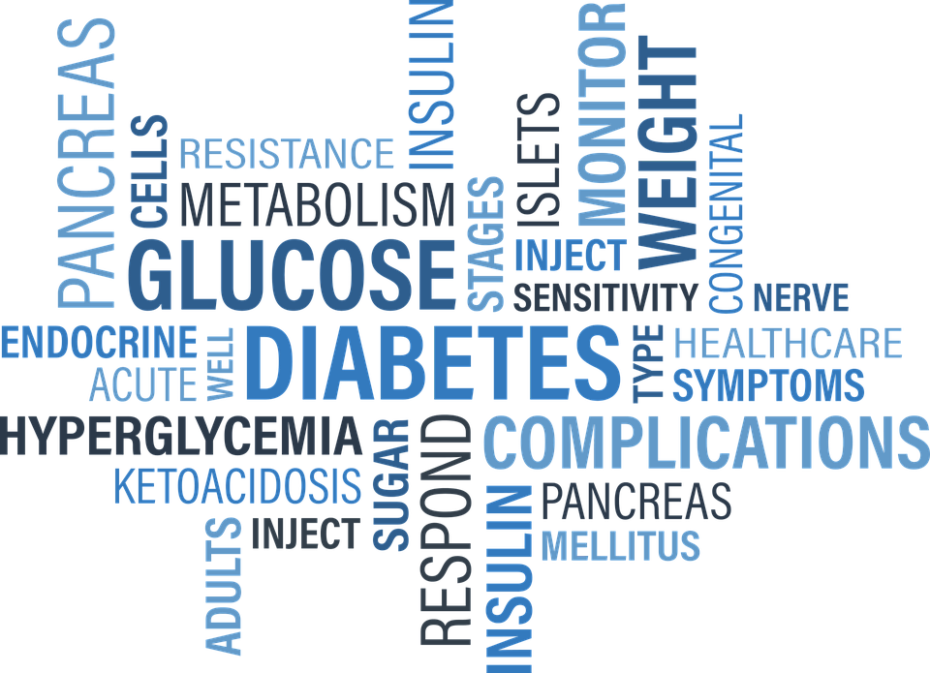
Goal
Ideally, this prescreen tool will aid in early detection of various diseases and ailments, improving health outcomes of the community by catching these diagnoses early enough to help prevent high cost care plans.
We hope this application provides a push in the right direction for healthcare professionals that work alongside A.I.

Slide 4


ETL
We retrieved our dataset full of various symptoms and associated diseases from Kaggle. https://www.kaggle.com/itachi9604/disease-symptom-description-dataset?select=dataset.csv
We cleaned our data by:
Correcting typos that were found
Removing underscores
Removing NaN values

Slide 5
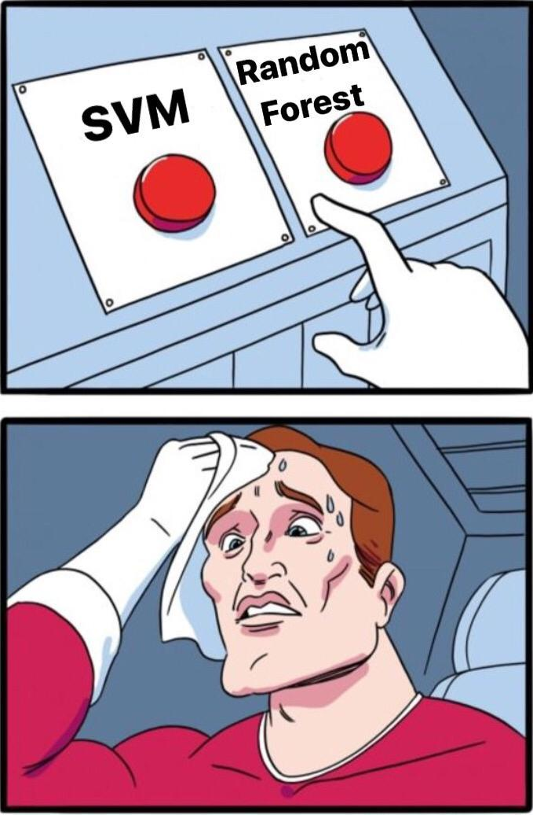
Choosing a suitable Machine Learning Algorithm
We took the size of our training set, the number of parameters, the training time and the type of problem we wanted to solve as key factors in choosing which algorithm to use.
Ultimately we chose the Random Forest Classifier because:
This algorithm provides higher accuracy and can handle missing values while maintaining the accuracy of a large proportion of data.
It also minimizes the risk of overfitting the data!

Slide 6

Evaluating the performance of our machine learning algorithm
We used the train-test split as a technique for evaluating the performance of our algorithm.
We took our dataset and divided it into two subsets:
Train Dataset: Used to fit the machine learning model.
Test Dataset: Used to evaluate the fit machine learning model.
By splitting the dataset (70% for the training set and 30% for the test) we minimized the discrepancies and gained a better understanding of the characteristics of our model.
After our model was processed by the training set, we tested the model against our test set.
We were able to achieve 100% accuracy via Random Forest Model !
We were able to retrieve an accurate diagnosis off two symptoms.
We used joblib to save our model.

Slide 7
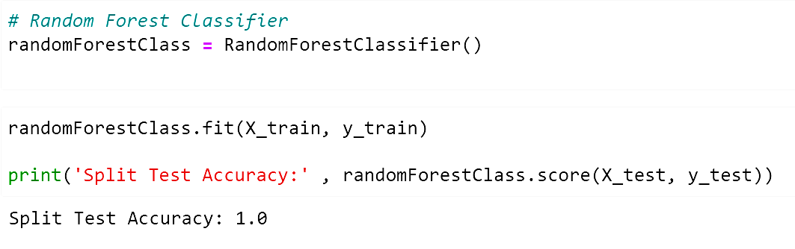
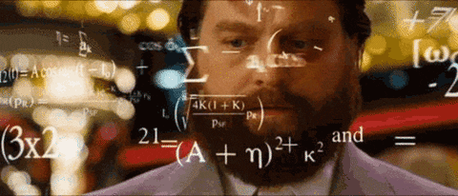
Random Forest Classifier/Split Test Accuracy

Slide 8
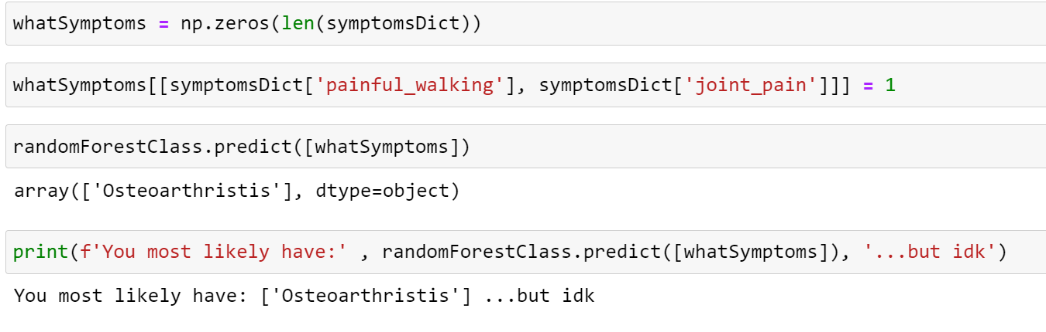
Two Symptom Diagnosis

Slide 9

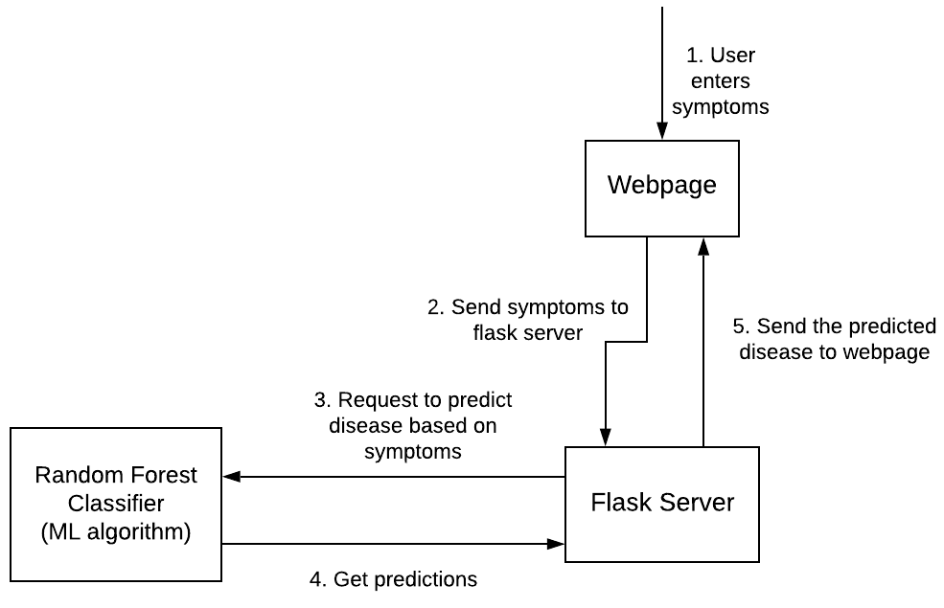
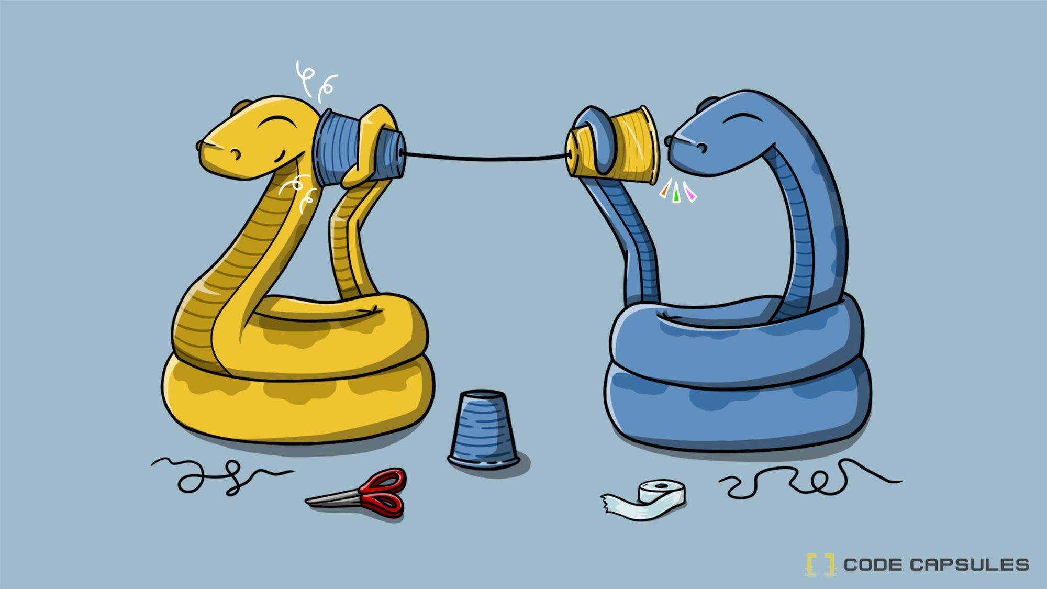
Workflow of Web Page

Slide 10
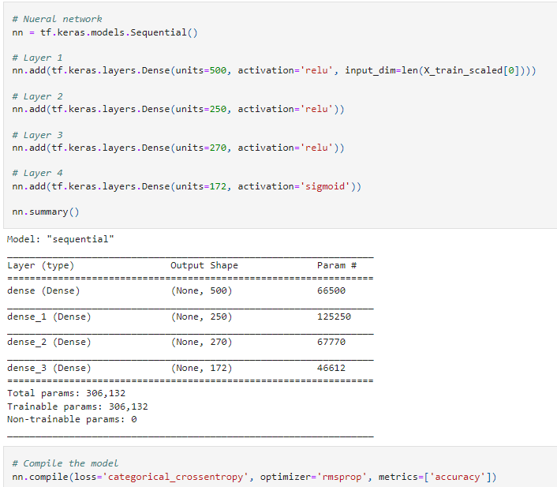
Neural Network Layers
First & second attempts had 3 layers.
First: 50 neurons each inner layer.
Second: 200 for first layer, 150 for second layer.
Both used binary cross entropy and adam, very low accuracy for both, around 1%
Third attempt added an inner layer.
Same number of neurons as pictured.
Switched to categorical cross entropy, still used adam optimizer.
Scored high 80% accuracy, loss around 20.
Fourth attempt changed optimizers.
Switched from adam to rmsprop.
Accuracy moved up to low 90% area, 18 - 19 loss.

Slide 11
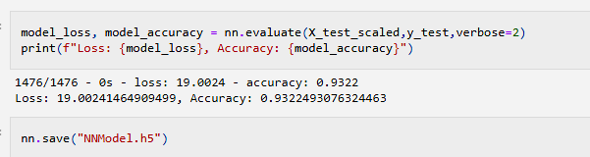
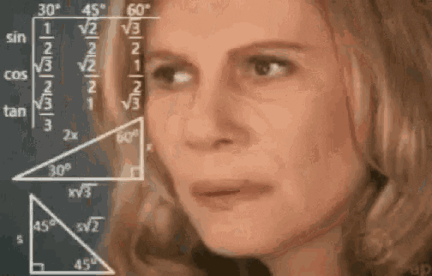
Final Neural Network Model

Slide 12
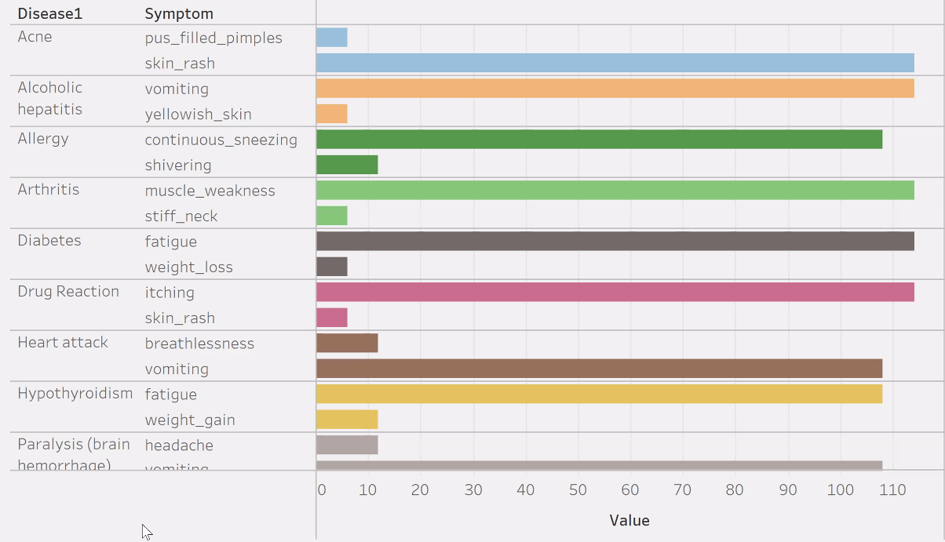
Tableau Visualization
This tableau visualization is showing specific sets of symptoms and the disease it is associated with.
The measure to the right is how many times that set of specific symptoms were reported by patients that then resulted in the diagnosis of the associated disease.

Slide 13
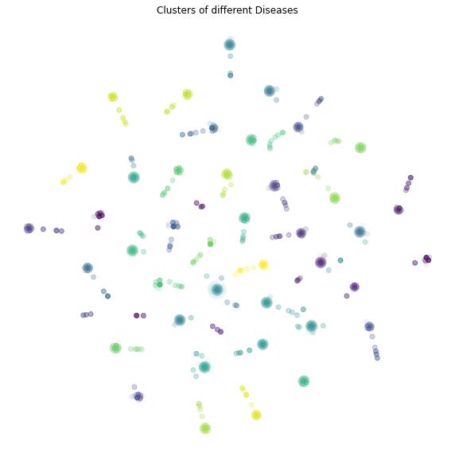
t-SNE Visualization
We used unsupervised learning settings because we are not trying to predict anything, just find interesting structures in the data.
To create this visualization we had to perform a dimensionality reduction with PCA. We then had to further reduce the dataset dimensions with t-SNE and visually inspect the results.
This created a scatter plot with clusters of colors to show how even when diseases may share some of the same symptoms it’s evident that they are it’s own cluster.
Each cluster is a different disease and they are grouped by color. If a cluster has the same color as others, that means they share a similar symptom!

Slide 14


 
 
 
 
 
 






 
 
 
 
 
 













